Slide 1
Unit 1
Basics of Problem solving and Programming

Slide 2
What is problem solving in programming?
A program is a list of instructions or program statements composed in such a way as to enable a computer to solve a problem. The problem to be solved is broken down into successively smaller parts.
There are four broad steps to the problem-solving method:
Understand the problem.
Devise a plan.
Carry out the plan.
Look back.
Thus, problem solving is the process of identifying a problem, developing an algorithm for the identified problem and finally implementing the algorithm to develop a computer program.

Slide 3
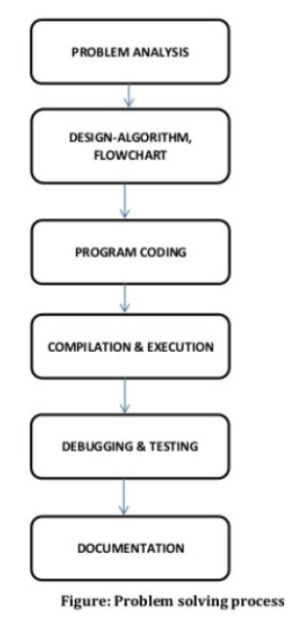
problem solving steps

Slide 4
What is computer programming?
A computer program consists of code that is executed on a computer to perform particular tasks. This code is written by programmers.
Computer programming is the process of writing code to facilitate specific actions in a computer, application or software program, and instructs them on how to perform.
A computer program is a sequence or set of instructions in a programming language for a computer to execute.

Slide 5
What is Python programing?
Python is a computer programming language often used to build websites and software, automate tasks, and conduct data analysis. Python is a general-purpose language, meaning it can be used to create a variety of different programs and isn't specialized for any specific problems.

Slide 6
Characteristics of A Computer Program
Efficiency.
Flexibility.
Usability.
Reliability.
Portability.
Maintainability.
Good documentation.
Good User Interface

Slide 7
Software Bug
A software bug is an error, flaw or fault in the design, development, or operation of computer software that causes it to produce an incorrect or unexpected result, or to behave in unintended ways.

Slide 8
Debugging
Debugging is the process of finding and fixing errors or bugs in the source code of any software. When software does not work as expected, computer programmers study the code to determine why any errors occurred.

Slide 9
Errors
Errors are the problems or the faults that occur in the program, which makes the behavior of the program abnormal, and experienced developers can also make these faults. Programming errors are also known as the bugs or faults, and the process of removing these bugs is known as debugging.

Slide 10
three types of error that can occur:
syntax errors.
logic errors/semantic errors
runtime errors.

Slide 11
A Syntax error
In computer science, a syntax error is an error in the syntax of a sequence of characters or tokens that is intended to be written in a particular programming language. For compiled languages, syntax errors are detected at compile-time. A program will not compile until all syntax errors are corrected.

Slide 12
Semantic errors
Semantic errors are mistakes in the meaning of the code. For example, you can use the wrong variable name or call a function with the wrong arguments.
Semantic errors are errors that occur when the code written by the programmer makes no sense to the compiler, even though it is syntactically correct.
A logic error is an error in the way a program works. The program can run but does not do what it is expected to do

Slide 13
Runtime Error
This error has occurred during runtime which means that occurs during program execution that is after compilation of the program.
Also called as exceptions.

Slide 14
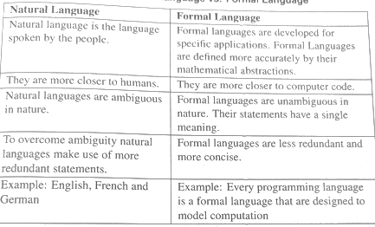
Natural Languages Vs Formal Languages

Slide 15
Programming Paradigm – 2 Approaches
Procedural and Object-oriented programming
Differences listed in Table:
Procedural | Object-oriented programming
In procedural programming data and operations on data are separated. | In object-oriented programming the focus is on the operations of objects which are a combination of data and procedures.
Procedural programming does not support the concept of data hiding and encapsulation. | Object-oriented programming supports the concept of data hiding and encapsulation.
Follows top –down programming approach | It follows bottom-up approach
Has limitations when size of program increases | Scalable programs can be developed
Usage of Global data for sharing information between functions is allowed | Data can be easily moved between methods and controlled through access specifiers

Slide 16
Compiler
A compiler is a software program that follows the syntax rule of programming language to convert a source code to machine code.
It cannot fix any error if present in a program; it generates an error message, and you have to correct it yourself in the program's syntax.
If your written program is correct (contains no error), then the compiler will convert your entire source code into machine code.
A compiler converts complete source code into machine code at once. And finally, your program get executes.

Slide 17
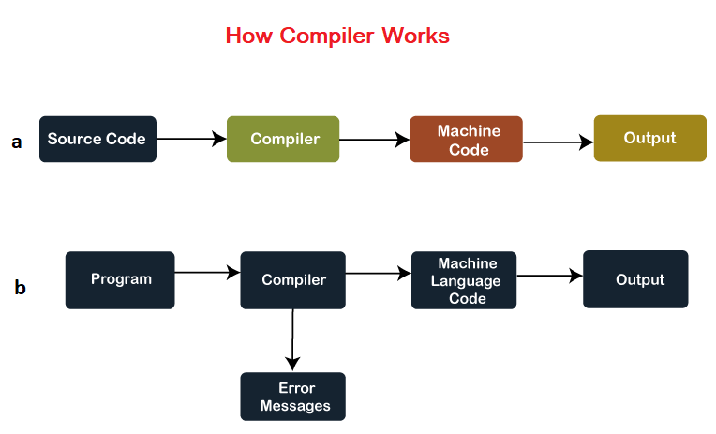
Compiled Programming

Slide 18
An interpreter
An interpreter is also a software program that translates a source code into a machine language. However, an interpreter converts high-level programming language into machine language line-by-line while interpreting and running the program

Slide 19
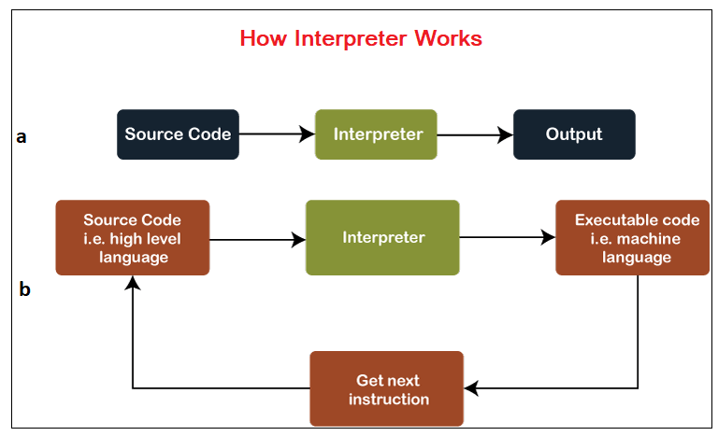
Interpreted Programming

Slide 20
Interpreted vs. Compiled -Differences
Interpreted | Compiled
The source code is directly executed by an interpreter. | The source code is first converted into a machine level code and then executed.
It executes the program step-by-step. | A compiler translates a program completely before it starts executing.
Debugging is easy | Relatively debugging is difficult for a compiled program.
Do not generate an intermediate code. | Compiler generate an intermediate code
Python, JavaScript, Ruby, PHP, Perl.
C, C++, Java, Go, Rust

Slide 21

Typed vs Typeless Programming Languages
Typed | Typeless
Declaring variables by specifying its data types | The value of the variable determines the data type
Type checking is made at compile time | Type checking is made at Runtime
Programmer has to keep track of different types and assign values accordingly | No need to keep track, its determined by type of the value a variable holds
Easy to understand | Difficult in understanding
Ex: C,C++,Java | Ex:- Python, Perl,PHP

Slide 22
Algorithms and Flowcharts

Slide 23
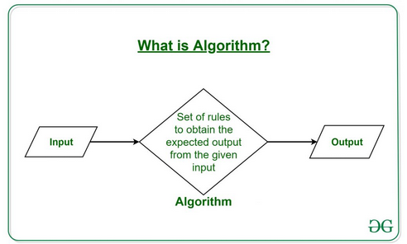
Algorithms
A set of rules/instructions that must be followed when solving a particular problem or a specific task.
Algorithms can be simple and complex depending on what you want to achieve.
Algorithm is generally developed before the actual coding is done.

Slide 24
What is the need for algorithms:
1.Algorithms are necessary for solving complex problems efficiently and effectively.
2.They help to automate processes and make them more reliable, faster, and easier to perform.
3.Algorithms also enable computers to perform tasks that would be difficult or impossible for humans to do manually.
4.They are used in various fields such as mathematics, computer science, engineering, finance, and many others to optimize processes, analyze data, make predictions, and provide solutions to problems.

Slide 25
Characteristics of an Algorithm?
Algorithm
input
Effective computational operations
Unambiguous operations
Well ordered
Has a result
Takes finite amount of time

Slide 26
Advantages of Algorithms:
It is easy to understand.
An algorithm is a step-wise representation of a solution to a given problem.
In Algorithm the problem is broken down into smaller pieces or steps hence, it is easier for the programmer to convert it into an actual program.
Disadvantages of Algorithms:
Writing an algorithm takes a long time so it is time-consuming.
Understanding complex logic through algorithms can be very difficult.
Branching and Looping statements are difficult to show in Algorithms(imp).

Slide 27
EX: - write an algorithm to find larger of the two numbers
Input: Two numbers x,y
Output: Larger number – x or y
Step 1: start
Step2: Read values of x and y
Step3: compare x and y : if x>y then
Step4 : x is larger
Stpep5: else
Step6:y is larger
Step7:stop

Slide 28
Flowchart:
The solution of any problem in picture form is called flowchart. It is the one of the most important technique to depict an algorithm.
Advantage of Flowchart:
Easier to understand
Helps to understand logic of problem
Easy to draw
Complex problem can be represent using less symbols
It is the way to documenting any problem
Helps in debugging process

Slide 29
